Slide 1
Convict Recognition
-Nikunj Khandar (16IT041)
-Jimesh Langadiya (16IT045)
Guided By : Prof Kamlesh Makwana

Slide 2

Problem Statement
Someone who is declared as a guilty of a criminal offense by a judge in a court of law is known as a CONVICT.
All these convicts are placed in a correctional facility which we call Prison.
Due to high security there is no chance of escape by the convicts from the prison.
But there are some consequences like granted parole which may lead prisoner to escape.
These escaped prisoners are a threat to the society so they must be caught as soon as possible.
This can be carried out in very smart and simple way with the help of our Convict Recognition.

Slide 3
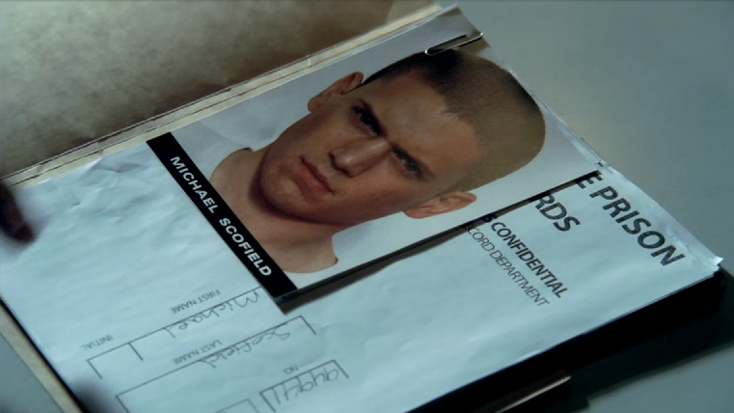
Solution
Each and every convict has to pass through certain process from which one of them is photos of convict from all angles.
A database can be created for the information about all the convicts including their photographs.
With the help of Convict recognition any escaped convict caught in the camera will be recognized and his/her location will be known.

Slide 4
Tools and Technologies
Programming Language : Python
IDE : Spyder
Open CV (Open source computer vision library).
NumPy (for supporting large multi-dimensional arrays).
OS library (File handling)
PIL (Python imaging library).
SQL Lite (For Database connectivity)

Slide 5
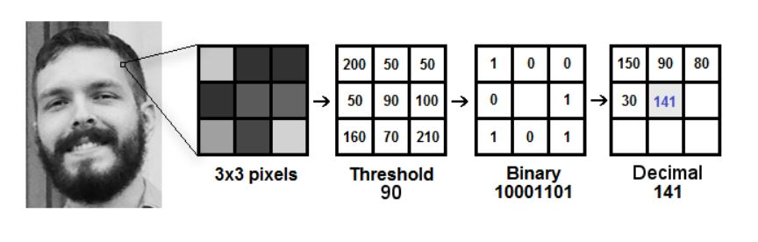
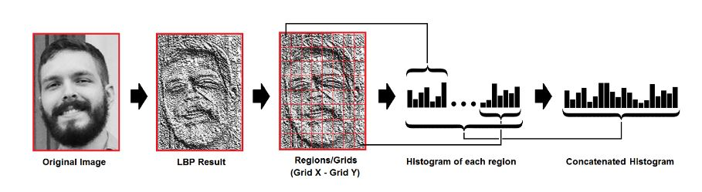
Face Recognition Algorithm (used)
Local Binary Patterns Histograms

Slide 6
Flow of Project:
Step 1 : Creating datasets of the new person in the form of images and storing them.
Step 2 : Training from the datasets from captured images and storing it into a file.
Step 3 : Detecting the face using camera and recognizing it as per trained.

Slide 7
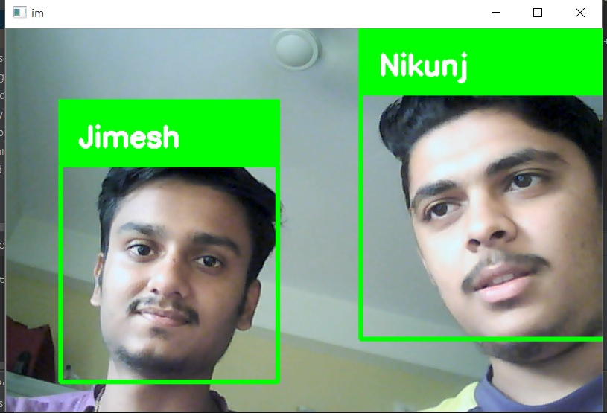
Snapshot:

Slide 8
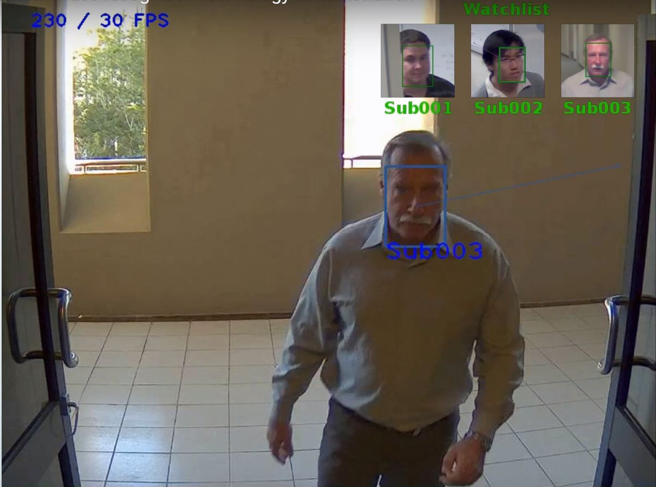
Continued:

Slide 9
Future Enhancements:
Adding Database Connectivity to the project so that there will be no limit of Data of the faces of convicts.
Increasing training and recognizing speed.
Adding criminal record to the database so that at the time of recognition of the escapee his/her criminal profile can be known.
More and more convicts can be added without any limit.

Slide 10
References:
https://pythonprogramming.net/
https://stackoverflow.com/
https://towardsdatascience.com/face-recognition-how-lbph-works-90ec258c3d6b
https://thecodacus.com/

Slide 11
Thank You

